Slide 1




Bashaier…
Egypt’s M-Agriculture Channel
Bashaier… The 1st Agriculture Marketing Network in Egypt
combining an inclusive business approach
to ICT development
focused on the small farmers and their market linkages
A project of Knowledge Economy Foundation funded by RDI

Slide 2
Agribusiness in Egypt’s Economy
Egypt’s rural economy
7 million farmers in Egypt
70% of the cultivated land in small holdings of less than 5 acres
Rural exodus expels youth to urban slums or migration
Agribusiness ecosystem: 50%+ of Egypt’s economy
The eco-system
5688 agriculture cooperatives
2500 NGOs involved in agriculture
20000 market buyers: food processors, exporters, retail chains
30000 input suppliers, service providers & banks
50000 research centers, faculties & schools

Slide 3
KMCS:
The development enabler of the Agribusiness eco-system
Integrating the small farmers and the agribusiness BOP in the value chain is a prime necessity for food security;
Inclusive business approaches linking market buyers to small farmers are gaining ground, and enabling market-driven crop production cycles;
Facilitating access to research and innovation for small farmers is a pre-condition to agribusiness development;
Value chain strategies are leading agribusiness development thus requiring networks operated by KMCS tools.

Slide 4
Innovation: at the core of public and private initiatives
and programs in the agribusiness eco-system
Building and sustaining market linkages are leading int’l and bilateral donors programs , thus favoring the funding of innovative solutions , which have KMCS as its basic tool;
Private funding enables the set-up of marketing management platforms securing the linkage with small farmers; based on CSR schemes and services subscriptions;
KMCS media and specially mobile apps allow access to revenue sharing schemes with mobile operators as well as financial services providers ;
Small farmers and entrepreneurs adoption of KMCS is secured when built into their business process.

Slide 5
The Value Chain Inclusive Business Approach
“Improved income through better marketing” is the primary motive for triggering change in the rural communities & for securing sustainability of capacity building projects.
Small farmers communities are viable IF linked to a network enabling their integration in their value chain, and supported by ICT, within a sustainable inclusive business approach.
Rural development is linked to the creation of new activities within the agriculture value chain, generating youth employment and Village Entrepreneurs opportunities, such as post-harvest activities, forward and backward linkages and ICT-based technologies.

Slide 6
Bashaier Network Virtuous Triangle Model
The 1st agrifood digital network on mobile apps, web and SMS and online marketplace
Online marketplace for crops and input supplies
Market information and extension services
The value chain marketing management platform
Managing the contract farming and supply contracts requests of the market buyers
Promoting good agricultural practices and linkages with the input suppliers
The small farmers associations network
Capacity building to marketing procedures and management of their marketing plans
Support in developing supply contracts skills and new post-harvest activities

Slide 7
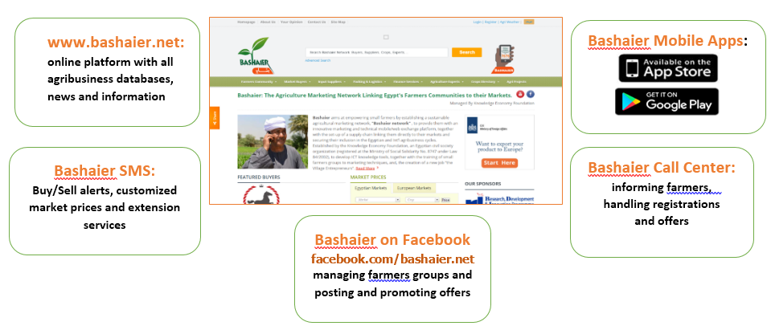
Egypt’s Agrifood Digital Marketing Network

Slide 8

Bashaier M-Agriculture Channel
#1 comprehensive mobile application in the agribusiness sector in Egypt
Focused on the small farmers and the SMEs;
Combining a “marketplace” with knowledge supply.

Slide 9

Bashaier M-Agriculture Channel
Serving the main small farmers needs
Marketplace for crops and input supplies;
Market prices;
Extension services;
Managing Buy/Sell Offers;
Updating small farmer profile.

Slide 10
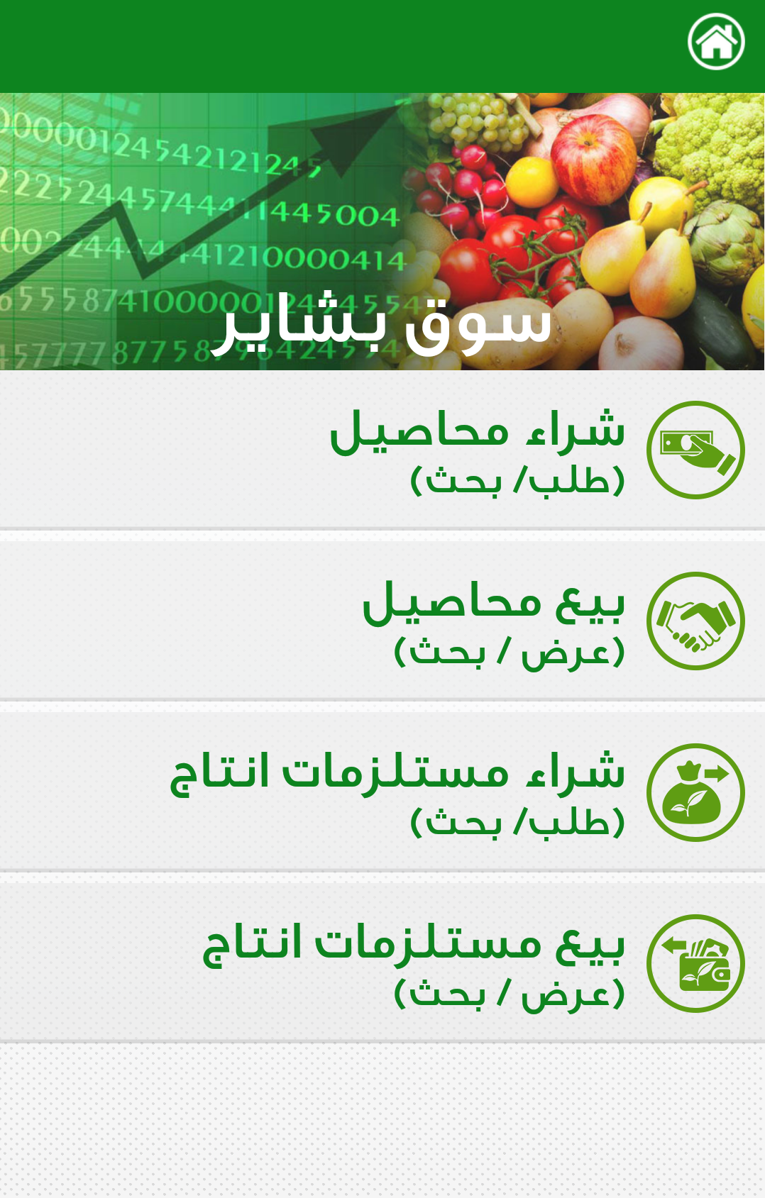
Bashaier M-Agriculture Channel
Bashaier Online Marketplace supports the 4 main marketing operations:
Buy offers for crops
Sell offers for crops
Buy offers for input supplies
Sell offers for input supplies
Buy/Sell Offers allow to select “contract farming” or “supply contracts” or “spot deals”
Buy/Sell Input Supplies combines inputs type and related crop

Slide 11
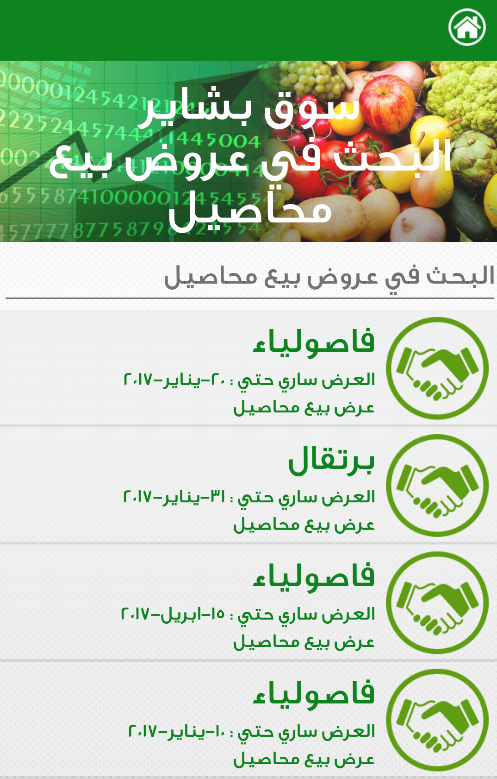
Bashaier M-Agriculture Channel
Publishing the “Buy” and “Sell” offers for crops and input supplies
Offers details enable to match exactly buyers and sellers;
Listing all offers allows to select the one suited to the buyer or seller needs;
Each match or selection receives the contact details corresponding to his offer by SMS.

Slide 12
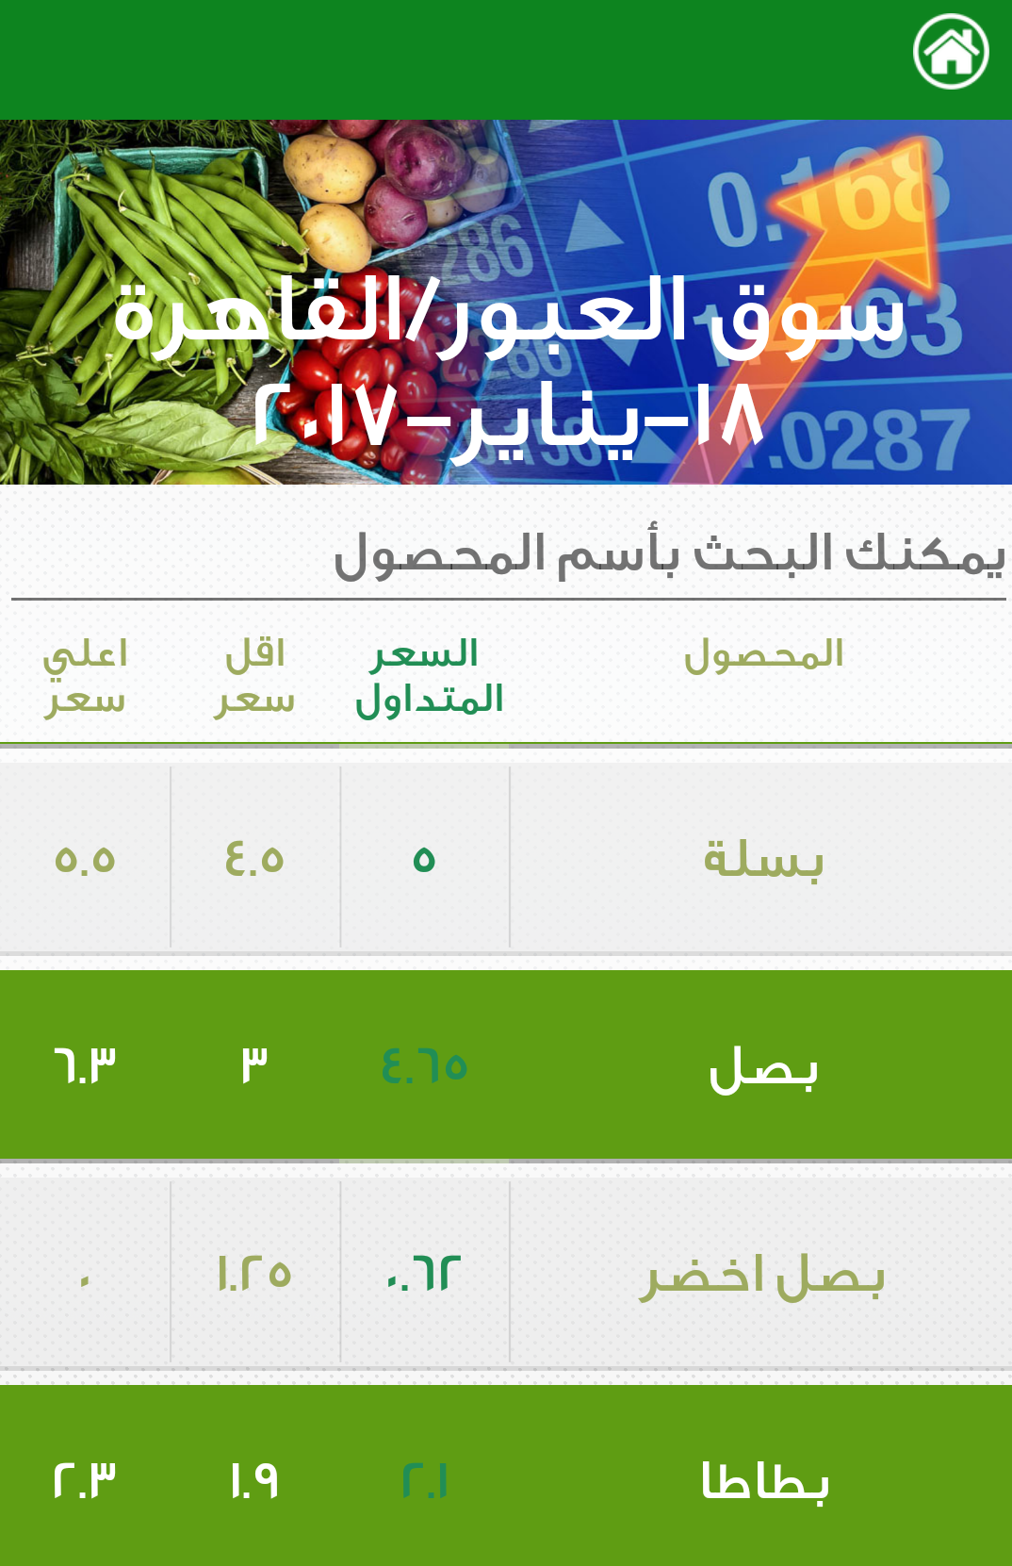
Bashaier M-Agriculture Channel
Daily Market Prices
In cooperation with Obour Market, for all vegetables, fruits and medicinal and aromatic plants;
Highest, lowest and average daily prices are published on Bashaier mobile applications and web portal;
SMS messages to the farmers for the crops selected when registering to the service.

Slide 13
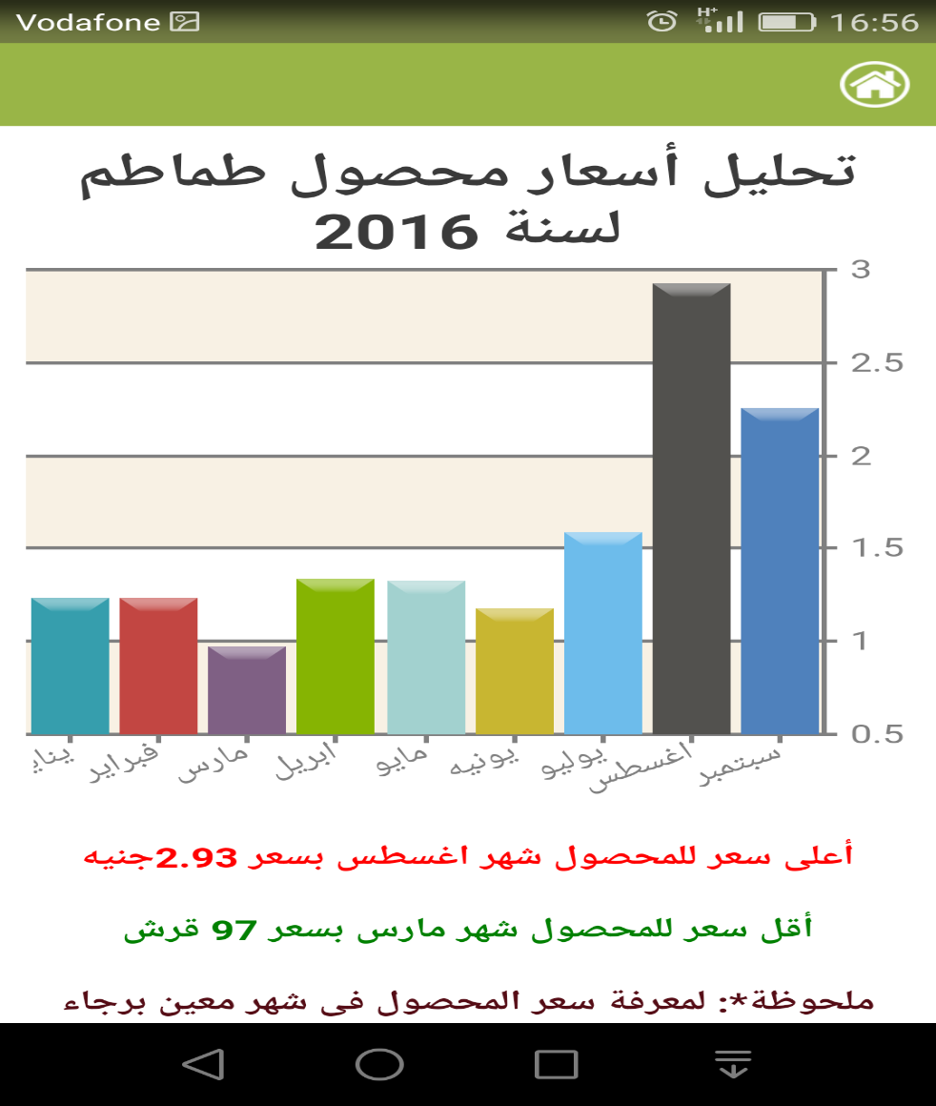
Bashaier M-Agriculture Channel
Analysis of Crops Market Prices
Analysis of crop prices for last 3 years providing the highest and lowest price per month
By using this analysis, the farmer will be able to better plan his crop cycle.
By using this analysis, the farmer will be able to better negotiate prices for the crop.

Slide 14
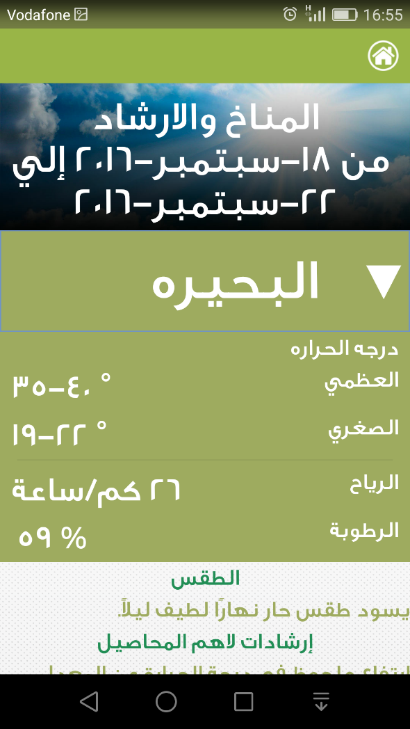
Bashaier M-Agriculture Channel
Weather/technical tips & extension
In cooperation with the Agricultural Research Center (ARC), Bashaier sends daily/weekly weather forecasts, related technical advice (irrigation and pest control) and best agriculture practices;
This includes: the 10 most important crops in each governorate;
Sending by SMS to farmers according to their location.

Slide 15
The Value Chain Marketing Management Platform
Operating the value chain linkages the Buy side
Mapping the market buyers and promoting direct linkages and contracts with small farmers associations;
Targeting: factories, retail chains, exporters , etc…;
Linking input suppliers directly to the small farmers.
Operating the value chain linkages the Sell side
Matching the small farmers and their associations to the market buyers crops supply needs;
Designing and managing contract farming and supply contracts;
Assisting Coops/NGOs to manage bulk selling and buying on behalf of farmers.
Managing the value chain marketing platform.

Slide 16
The small farmers associations network
Managing the network of small farmers communities with a business oriented approach:
Selecting the active farmers Coops/NGOs:
to date, 70 associations are member of “Bashaier Network”;
Marketing plans for the farmers crops and promotion through Bashaier Network;
Enabling the small farmers associations to develop sustainable market linkages with both the market buyers and the input suppliers;
Promoting market-driven rural MSMEs opportunities: SSP and modern agriculture service centers, post-harvest activities, etc…

Slide 17

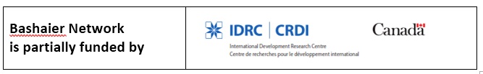
KEF/Bashaier Partners

Slide 18
Knowledge Economy Foundation
NGO (No. 8747/Law 84) created by entrepreneurs with social business interests, and experts in ITC, business information, agrifood, to address the lack of knowledge management and dissemination at the core of Egypt’s development challenges.
Vision: Knowledge applied to business activities enables bottom-up empowerment, while generating entrepreneurship and competitiveness.
Mission: Develop inclusive business approaches focusing on MSMEs linkage to their markets, through the set-up of sustainable marketing networks using ICT-based tools and targeting the agribusiness value chains representing 50%+ of the economy and of the Egyptians livelihood.

Slide 19

Bashaier/KEF projects
The World Fish Organization is conducting several programs in Egypt since many years. A new program aiming at improving fish farmers income is being launched funded by the Swiss Agency for Development and Cooperation. World Fish has selected KEF to implement a digital marketing platform for the fish value chain, on the model of the Bashaier one for horticulture.

Slide 20

Bashaier/KEF projects
A Dairy mini-hubs program funded by IDRC/International Development Research Centre of Canada, and developed in cooperation with the Faculty of Agriculture, Ain Shams University, to design and test optimum models for regrouping small dairy farmers output into existing and/or new mini-hubs collecting centers and offering them comprehensive technical and marketing services to enable income growth.

Slide 21

KEF consultancy projects
NEMO Egypt is a project of the Italian Cooperation for the rural development of Marsa Matrouh communities. KEF is in charge of providing technical and legal expertise to the small farmers of Matrouh for the establishment of a farmer’s association, develop their business plan and train them to its management and marketing procedures.

Slide 22

KEF consultancy projects
On behalf of the ILO/ International Labour Organization, KEF is in charge of adapting to the Egyptian market the successful methodology developed by the ILO in several Asian countries to train the range of local government officers and business providers to study and design the potential business opportunities at local level, based on innovative “ToT” approach.

Slide 23


KEF consultancy projects
Within the African Development Bank latest agriculture program with the Social Fund for Development, KEF implemented together with ENCC an advocacy program and participatory dialogue on the new agriculture laws. The program included the organization of high level workshops representing all stakeholders, together with the presentation of case studies and the organization of focus groups, to produce a policy brief with the related recommendations.

Slide 24


KEF consultancy projects
Operating as Egyptian partner within the consortium led by Sofreco, to implement part of the EU funded new vocational training program, TVET2, to develop and relaunch Egypt’s national vocational training program.

Slide 25
Thank You

