Slide 1
Towards Building a Knowledge-based Economy …
EGYPT’S
SCIENCE AND TECHNOLOGY DEVELOPMENT FUND (STDF)
Hazem Mansour, Ph. D.
Acting Executive Director

Slide 2
The Dynamics of Change: 2007
Higher Council for Science & Technology
(HCST)
MoHESR
Universities
Research Centers

Slide 3
STDF National Research-Funding Mechanisms
Basic & Applied Research
Up to 1,000,000 EGP/project
2-3 years
Different areas of research:
Agriculture, Chemistry, Physics, Mathematics, Geology and Mineral Resources, Space and Remote Sensing, Food, Biology, Water, ICT, Social Sciences and Humanities, Transportation and traffic, Engineering, Energy, Electronics, Environment, Industry Biotechnology, Nanotechnology, Medicine, Pharmacy, Oceanography & Fisheries, Biochemistry, Microbiology, Converging Sciences, Foresight Studies
Centers of Scientific Excellence
Development & Innovation
1-Technology Development
2-Innovation Grants
3-Faculty For Factory (3F)
4-Demand Driven Projects
5-Research Centers Networks
6-National Challenges Program
7-Technology Incubators
Targeted Calls
Capacity Building
1-Short Term Fellowship
2-Support of Scientific Events
3-Instrument Acquisition
4-Digital Libraries
5-Reintegration
6-Young Researchers
7-Research Support

Slide 4
Examples of STDF Funding Programs
Goal |  | Programs
Supporting the Industry/Market Pull Mode |  | Demand Driven Projects National Challenge Projects Faculty for Factory
Supporting the Technology Push Mode |  | Technology Development Innovation Grants Technology Incubators Research Support
Human & Research Facility Capacity Building |  | Short Term Fellowships Centers of Excellence Lab Instrumentation Acquisition
Minimizing the Brain Drain |  | Reintegration Grants Young Researcher Grants

Slide 5
Examples of STDF Funding Programs
Capacity Building Grants
Support of Scientific Events
Instrument Acquisition & maintenance
Nanotechnology Center (CU)
Young Researcher
Reintegration
Allocated budget: 220 M EGP
Ph.D. from a reputable Uni.
< 40 yrs
3 Years
1,000,000 EGP
YR based in Egypt
< 40 yrs
3 Years
750,000 EGP
50,000 EGP
Equipment purchase
5 M EGP
Must be aligned with an institutional long term plan
Research Support
Ph.D., M.Sc. or graduation projects
1 year
100,000 EGP
Digital Libraries
Short Term Fellowship
Supporting Digital Libraries (2009):
16 M EGP
4 Months
<40 years

Slide 6
Examples of STDF Funding Programs
Innovation
Innovation
Projects
Industrial Modernization Center (IMC) Joint Fund
Faculty for Factory
(FFF)
Technology Development
100,000 EGP
1 year
Funding small prototyping projects and concept validation
Funding scientific innovation till the development of prototype
1,000,000 EGP
Up to 3 years
4 months
Product & Process development:
1,2 Million EGP
Demand Driven Program (DDP)
National challenges Program (NCP)
1.5 million EGP
2 years
End user/Beneficiary

Slide 7
INTERNATIONAL COOPERATION PROGRAMS
Research
300 K $/YEAR
40 K $/project
Research $60,000/ project
German Egyptian Research Fund (GERF)
€100,000/project
German Egyptian Scientific Exchange & Excellence Development (GE-SEED)
Mobility: 125 K €/year
€30,000/project
16 M $/5years
Collaborative Research $200,000/project
Junior scientists visits $30,000/project
Research 145,000 EGP/
project
Seminars 85,000 EGP/project
Research $60,000/ project
Research €50,000/project
Chair of Excellence €150,000/ project
Mobility €5,000/project
2 M £/year
Research projects
Workshops
Mobility
NEW
Research (3y) 240.000 EGP/
project
Research projects (50 K €/Project)
Mobility
10 Joint Research Projects/CALL
1 M EGP/project
10 Joint Research Projects/year
1.7 M EGP/project

Slide 8
INTERNATIONAL COOPERATION PROGRAMS
PRIMA
LEAP-AGRI
1.5 M €/year
+ 300 K € in kind/year
(up to 10 years)
Collaboration between Euro-Mediterranean countries in common challenging fields
Up to 750 K €/call
Collaboration between European and African countries in common challenging fields
Up to 1 M €
Collaboration between Euro-Mediterranean countries in common challenging fields
Up to 750 K €/call

Slide 9
STDF Funding Statistics
Budget Distribution over STDF Grants since 2008 until 2015
(In Million EGP)

Slide 10
Impact on Scientific Community
Capacity Building Program (4 Calls)
Institutes | # of Proj. | Budget | Budget %
Alexandria University | 10 | 39.27 | 9%
Ain Shams University | 8 | 33.58 | 8%
National Research Center | 9 | 32.68 | 7%
Mansoura University | 9 | 31.85 | 7%
Cairo University | 8 | 29.70 | 7%
Assiut University | 7 | 23.49 | 5%
National Institute of Oceanography & Fisheries | 4 | 18.98 | 4%
Kafr El Shiekh University | 4 | 15.51 | 4%
Suez University | 3 | 14.84 | 3%
Tanta University | 4 | 14.49 | 3%
Banha University | 4 | 13.67 | 3%
Zewail City of Science &Technology | 3 | 13.12 | 3%
Zagazig University | 3 | 12.41 | 3%
Suez Canal University | 3 | 11.90 | 3%
Fayoum University | 3 | 11.86 | 3%
Minia University | 2 | 10.00 | 2%
Egypt-Japan University of Science and Technology | 2 | 9.98 | 2%
Damanhour University | 2 | 9.94 | 2%
National Authority for Remote Sensing & Space Sciences | 2 | 9.80 | 2%
Beni-Suef University | 2 | 9.76 | 2%
City of Scientific Research and Technological Applications | 2 | 9.71 | 2%
Suhag University | 2 | 9.57 | 2%
Sadat City University | 2 | 7.70 | 2%
Menofia University | 2 | 6.28 | 1%
Al Azhar University | 2 | 6.03 | 1%
Academy of Scientific Research and Technology | 1 | 5.00 | 1%
National Research Institute of Astronomy and Geophysics | 1 | 5.00 | 1%
South Valley University | 1 | 4.85 | 1%
Helwan University | 1 | 4.78 | 1%
Central Metallurgical Research and Development Institute | 1 | 4.35 | 1%
Agriculture Research Center | 1 | 3.06 | 1%
Damietta University | 1 | 3.05 | 1%
TheadorBilhariZ Institute | 1 | 3.02 | 1%
Port Training Institute – Ministry of Transport | 1 | 1.36 | 0.3%
Total | 111 | 440.59
111 Capacity Building projects
with a total budget of 440.59 million EGP
For 34 institutes all over Egypt.

Slide 11
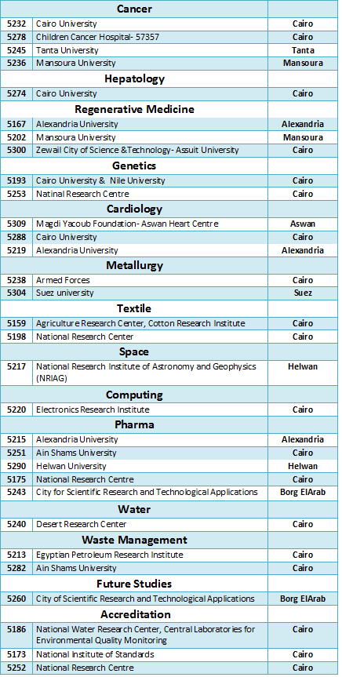
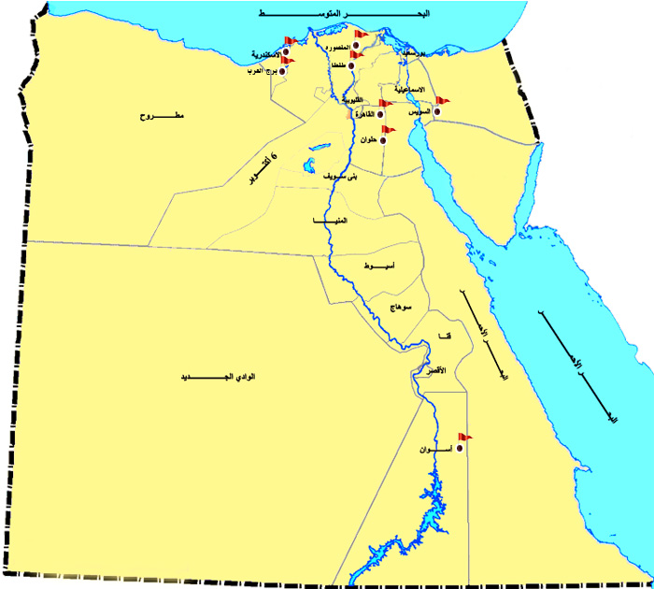
Impact on Scientific Community
Centers of Scientific Excellence
Centers of Scientific Excellence
Centers of Excellence: 31
Budget: 252.16 Million EGP

Slide 12
Impact on Scientific Community
Patents
Surge in patent filing related to STDF projects
STDF has applied for 65 patents, which are the outputs of 45 STDF funded projects.
Until Sept. 2015, 4 patents have been granted to STDF.
STDF contribution together with MCIT and IBM in supporting the Nanotechnology Center in Cairo University has led to applying for 44 patents .
Distribution of Applied STDF Patents over Scientific Fields

Slide 13
THANK YOU
Hazem Mansour
April 23rd, 2017

